Slide 1
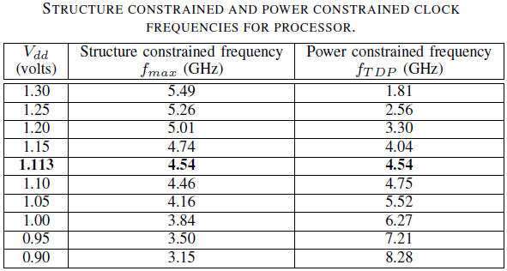
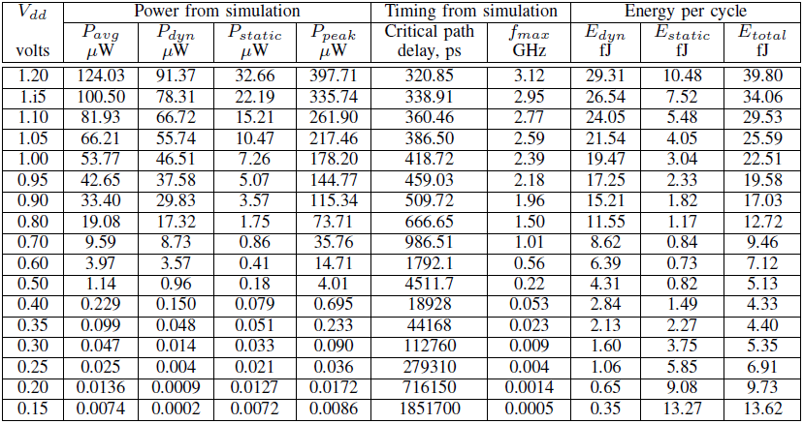
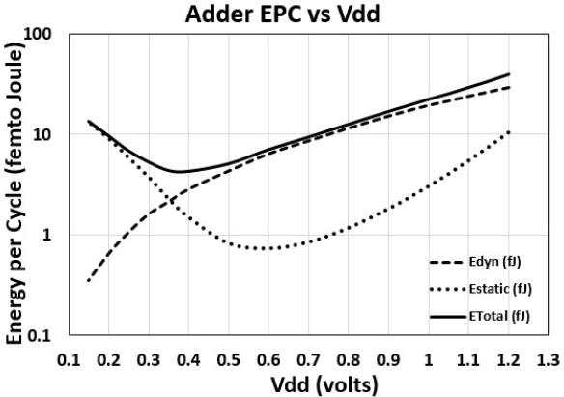
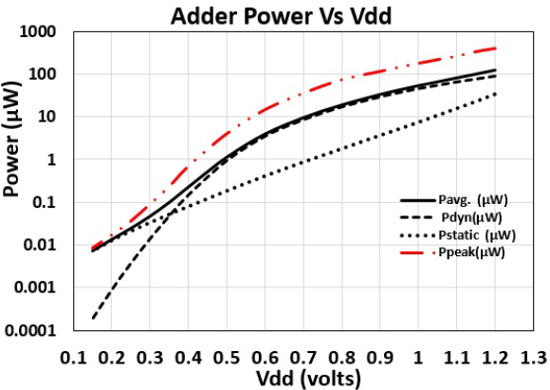
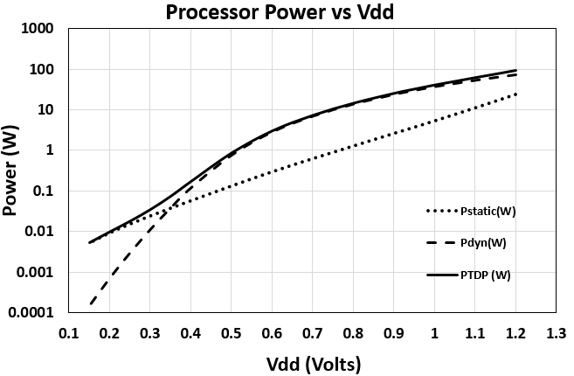
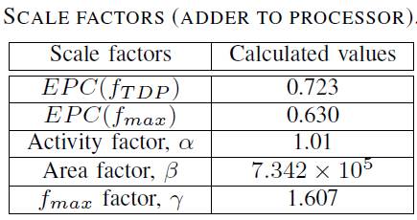
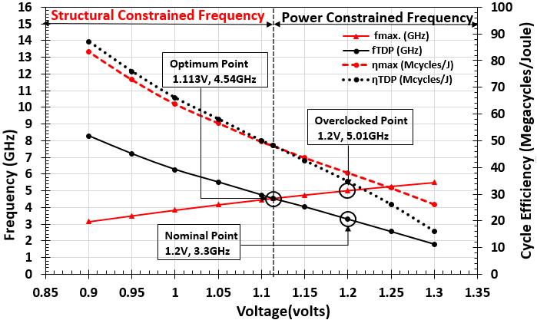
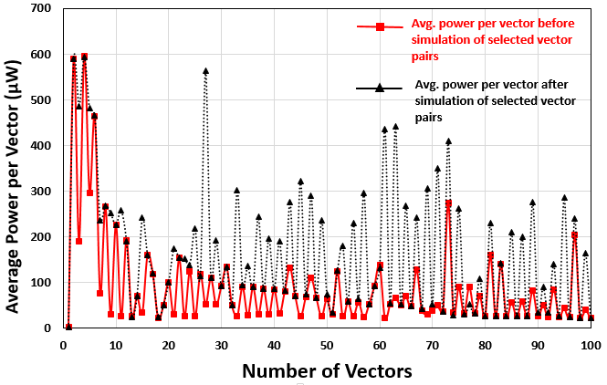
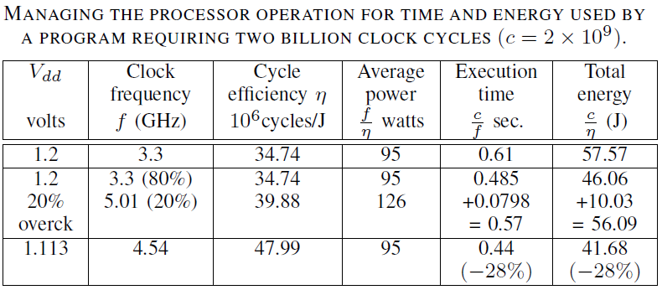
Characterizing Processors for Energy and Performance Management
Harshit Goyal and Vishwani D. Agrawal
Department of Electrical and Computer Engineering, Auburn University, Auburn, AL 36849
Abstract
Simulation Tools
Simulation Data of
Adder Circuit
We describe a method for power management of a processor. An Intel processor in 32nm bulk CMOS technology is used as an illustrative example. A ripple carry adder was simulated in H-spice for critical path delay, dynamic energy and static power at a wide range of supply voltages. The adder data is then scaled based on the clock frequency, supply voltage, thermal design power (TDP) and other specifications of the processor. To optimize the time and energy performance, voltage and clock frequency are determined showing 28% reduction both in execution time and energy dissipation.
Questa Sim
Design, compile and simulate designs
Leonardo Spectrum
ASIC and standard cell synthesis
Design Architect-IC
Schematic Capture
HSPICE
Circuit simulation and verification
Power Management
Micro-Benchmark Circuit Used
Problem Statement
Obtain data on voltage, frequency and cycle efficiency of a processor for power and performance management.
Determine operating conditions (voltage and frequency) for optimal time energy operations.
Processor Specifications
and Scale Factors
Adder circuit
Fundamental block of functional units
Often in processor’s critical path
Used 16-bit Ripple Carry Adder.
PTM Models (http://ptm.asu.edu/)
Characterized in two PTM models: bulk CMOS and High-K
Technology node: 45nm, 32nm and 22nm
Methodology
Technology Characterization: Simulate a reasonable size adder micro-benchmark circuit using selected vectors.
Scale adder data to obtain processor power (cycle efficiency) and frequency at different operating points using scale factors.
Develop power management scenarios using cycle efficiency and frequency.
Vector Selection
Power Constrained and Structure
Constrained Frequencies
Performances Measures
Time Performance of Processor
Speed of a processor is measured in cycles per second or clock frequency (f).
Execution time of a program using C clock cycles = C/f
Time performance = f/C
Energy Performance of a Processor
Efficiency of a processor may be measured in cycles per joule (1/EPC) or cycle efficiency (η)
Energy dissipated by a program using C clock cycles = C/ η
Energy performance = η/C
In a power constraint system, the frequency fTDP is limited by the maximum allowable power of the circuit.
For processor scaled curves of fmax and fTDP at various voltages. The exact cross point value (Vddop; fopt) is obtained by curve fitting the data with polynomial equations of degree 3.
In a structure constrained system, the frequency fmax is limited by the critical path delay of the circuit
1,000 random vectors were generated using a MATLAB code.
Out of 1,000, fifty vector pairs were selected such that 16 consume avg. power, 17 consume above avg. power including a peak power vector pair and 17 consume below average power including a min. power vector pair.
To maximize the performance we find the highest frequency, fopt that would exceed neither the power constraint nor the critical path constraint. At any given voltage the optimum frequency is obtained as,

